Slide 1
Lecture 9
Chapter 20: Entropy and the second law of thermodynamics
20-1 Irreversible process and entropy:
One-way processes: Processes can occur only in a certain sequence (the right way) and never in the reverse sequence (the wrong way). An egg is dropped onto a floor, a pizza is baked.
These one-way processes are irreversible, meaning that they cannot be reversed by means of only small changes in their environment.
The key to understanding why one-way processes cannot be reversed involves a quantity known as entropy.
Entropy postulate: “If an irreversible process occurs in a closed system, the entropy S of the system always increases; it never decreases”. [$∆S$ > 0]
Entropy differs from energy in that entropy does not obey a conservation law. The energy of a closed system is conserved; it always remains constant. For irreversible processes, the entropy of a closed system always increases.

Slide 2
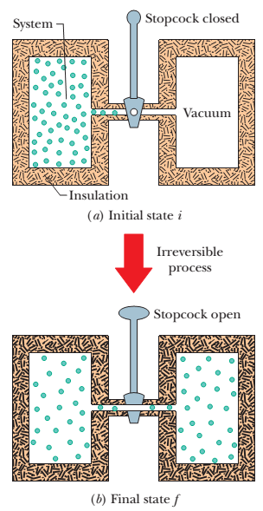
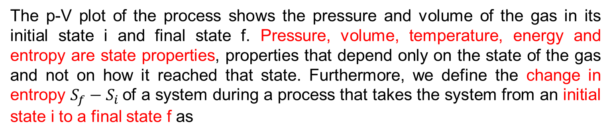
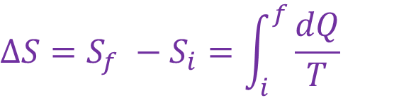
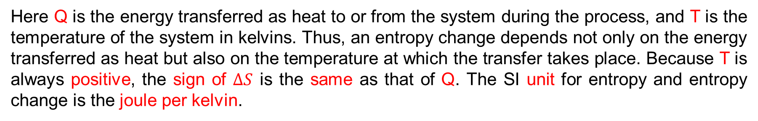
20-1 Change in entropy:
Irreversible free expansion:
Let’s consider the free expansion of an ideal gas. This is an irreversible process; all the molecules of the gas will never return to the left half of the container.
The p-V plot of the process shows the pressure and volume of the gas in its initial state i and final state f. Pressure, volume, temperature, energy and entropy are state properties, properties that depend only on the state of the gas and not on how it reached that state. Furthermore, we define the change in entropy $S_{f}−S_{i}$of a system during a process that takes the system from an initial state i to a final state f as
$$∆S=S_{f} −S_{i}=\int_{i}^{f}{\frac{dQ}{T}}$$
Here Q is the energy transferred as heat to or from the system during the process, and T is the temperature of the system in kelvins. Thus, an entropy change depends not only on the energy transferred as heat but also on the temperature at which the transfer takes place. Because T is always positive, the sign of $∆S$ is the same as that of Q. The SI unit for entropy and entropy change is the joule per kelvin.

Slide 3
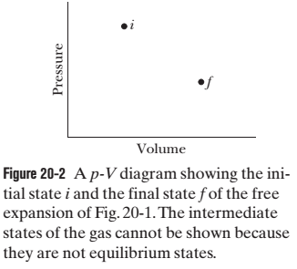
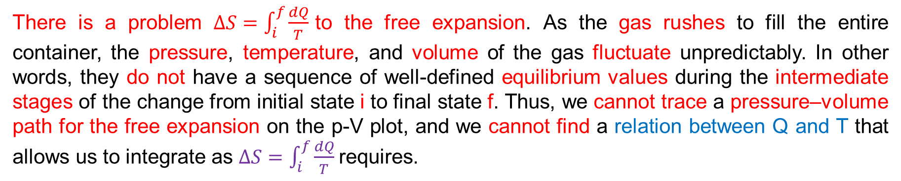
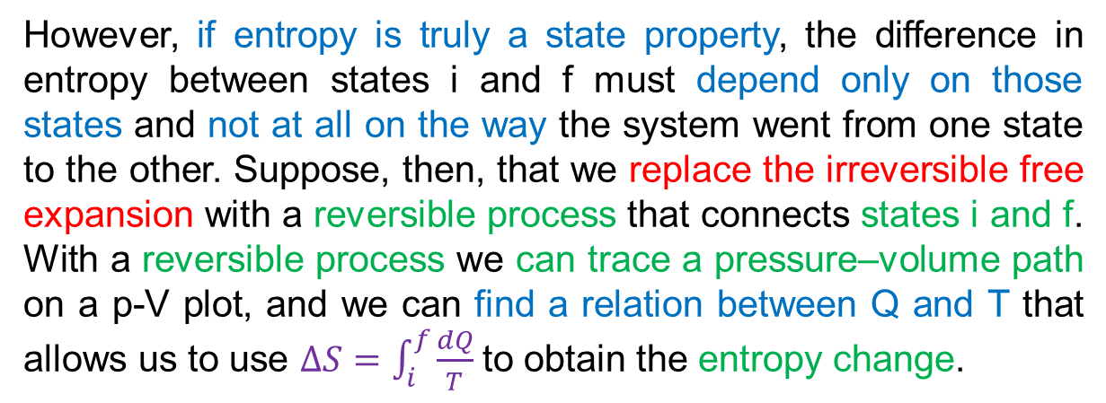
There is a problem $∆S=\int_{i}^{f}{\frac{dQ}{T}}$to the free expansion. As the gas rushes to fill the entire container, the pressure, temperature, and volume of the gas fluctuate unpredictably. In other words, they do not have a sequence of well-defined equilibrium values during the intermediate stages of the change from initial state i to final state f. Thus, we cannot trace a pressure–volume path for the free expansion on the p-V plot, and we cannot find a relation between Q and T that allows us to integrate as $∆S=\int_{i}^{f}{\frac{dQ}{T}}$requires.
However, if entropy is truly a state property, the difference in entropy between states i and f must depend only on those states and not at all on the way the system went from one state to the other. Suppose, then, that we replace the irreversible free expansion with a reversible process that connects states i and f. With a reversible process we can trace a pressure–volume path on a p-V plot, and we can find a relation between Q and T that allows us to use $∆S=\int_{i}^{f}{\frac{dQ}{T}}$to obtain the entropy change.

Slide 4
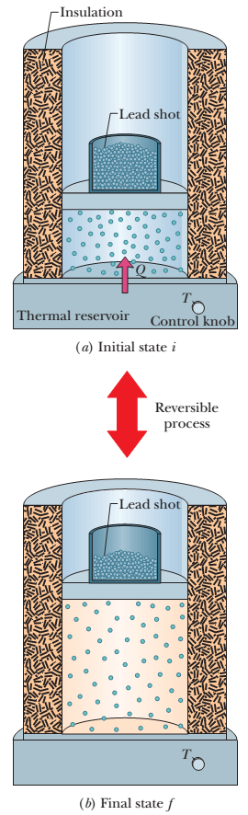
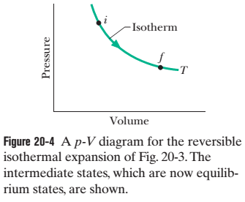
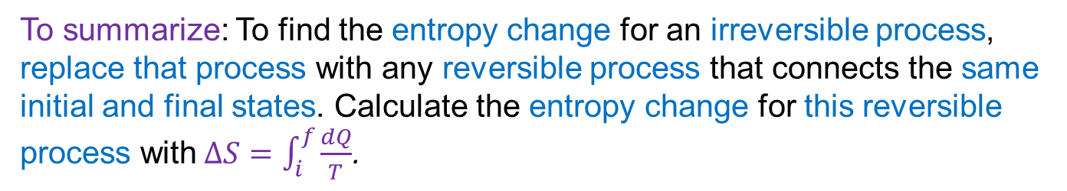
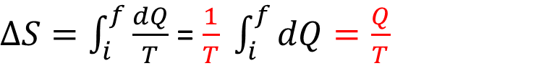
Reversible isothermal expansion:
The reversible isothermal expansion is physically quite different from the irreversible free expansion. However, both processes have the same initial state and the same final state and thus must have the same change in entropy. Because we removed the lead shot slowly, the intermediate states of the gas are equilibrium states, so we can plot them on a p-V diagram (Fig. 20-4).
$∆S=\int_{i}^{f}{\frac{dQ}{T}}$ = $\frac{1}{T} \int_{i}^{f}{dQ=\frac{Q}{T}}$
To keep the temperature T of the gas constant during the isothermal expansion, heat Q must have been energy transferred from the reservoir to the gas. Thus, Q is positive and the entropy of the gas increases during the isothermal process and during the free expansion.
To summarize: To find the entropy change for an irreversible process, replace that process with any reversible process that connects the same initial and final states. Calculate the entropy change for this reversible process with$∆S=\int_{i}^{f}{\frac{dQ}{T}}$.

Slide 5


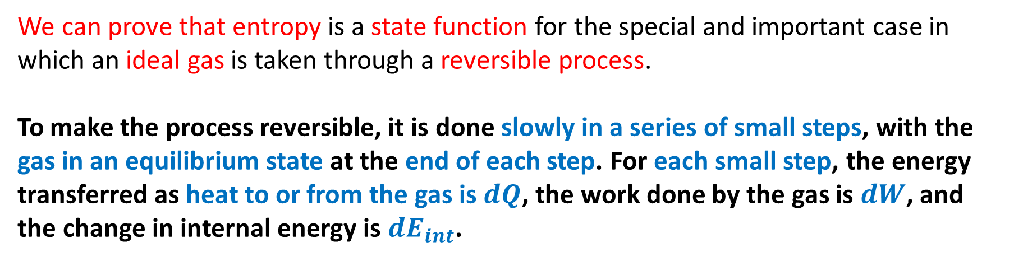

20-1 Entropy as a state function (state property):
We can prove that entropy is a state function for the special and important case in which an ideal gas is taken through a reversible process.
To make the process reversible, it is done slowly in a series of small steps, with the gas in an equilibrium state at the end of each step. For each small step, the energy transferred as heat to or from the gas is $dQ$, the work done by the gas is $dW$, and the change in internal energy is $dE_{int}$.
$First law of thermodynaics, dE_{int}$= $dQ− dW$
$$dQ= dW+dE_{int}$$
We know for reversible process, $dW = p dV$
$$dE_{int}=nC_{v}dT$$
$$dQ=p dV+nC_{v}dT$$

Slide 6
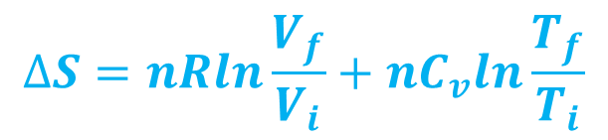

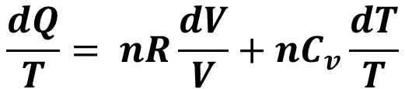
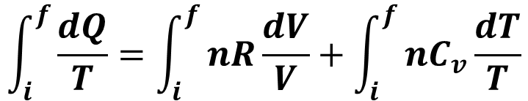
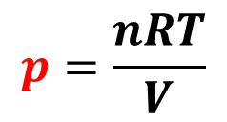
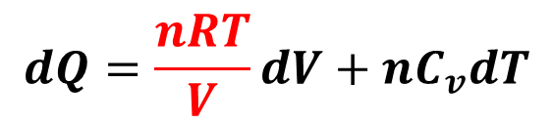
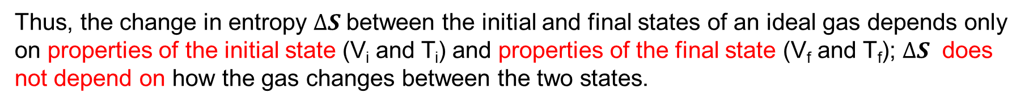
Ideal gas law, pV = nRT
$$p=\frac{nRT}{V}$$
$$dQ=\frac{nRT}{V}dV+nC_{v}dT$$
$$\frac{dQ}{T}= nR\frac{dV}{V}+nC_{v}\frac{dT}{T}$$
Integrating each term between an arbitrary initial state $i$ and an arbitrary final state $f$,
$$\int_{i}^{f}{\frac{dQ}{T}}=\int_{i}^{f}{nR\frac{dV}{V}}+\int_{i}^{f}{nC_{v}\frac{dT}{T}}$$
$$∆S=nR{[lnV]}_{i}^{f}+nC_{v}{[lnT]}_{i}^{f}$$
$$∆S=nRln\frac{V_{f}}{V_{i}}+nC_{v}ln\frac{T_{f}}{T_{i}}$$
Thus, the change in entropy $∆S$between the initial and final states of an ideal gas depends only on properties of the initial state (V_{i} and T_{i}) and properties of the final state (V_{f} and T_{f}); $∆S$ does not depend on how the gas changes between the two states.

Slide 7
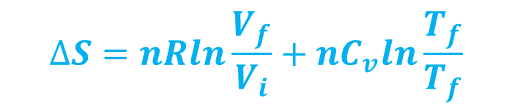
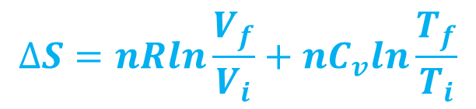
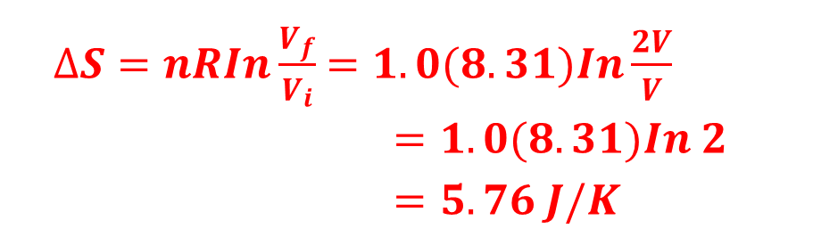


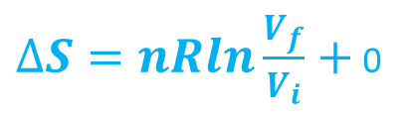

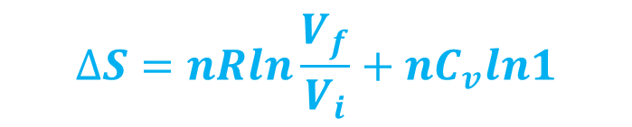
Sample Problem 20.02: Suppose 1.0 mol of nitrogen gas is confined to the left side of the container of Fig. 20-1a. You open the stopcock, and the volume of the gas doubles. What is the entropy change of the gas for this irreversible process?
Solution:
$Here, n=$ 1 mol
$$Vi=V$$
$$Vf=2V$$
T_{i} = T_{f}
$$∆S=nRln\frac{V_{f}}{V_{i}}+nC_{v}ln\frac{T_{f}}{T_{i}}$$
$$∆S=nRln\frac{V_{f}}{V_{i}}+nC_{v}ln\frac{T_{f}}{T_{f}}$$
$$∆S=nRln\frac{V_{f}}{V_{i}}+nC_{v}ln1$$
$∆S=nRln\frac{V_{f}}{V_{i}}+$ 0
$∆S=nRIn\frac{V_{f}}{V_{i}}$ $=1.0(8.31)In\frac{2V}{V}$
$=1.0(8.31)In 2$
$=5.76 J/K$

Slide 8
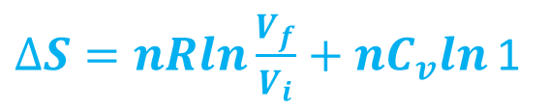

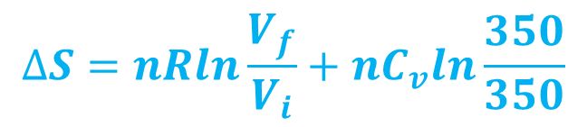





2. An ideal gas undergoes a reversible isothermal expansion at 77.0 ⁰C, increasing its volume from 1.30 L to 3.40 L. The entropy change of the gas is 22.0 J/K. How many moles of gas are present?
$n=\frac{∆S}{RIn\frac{V_{f}}{V_{i}}}$
n = $\frac{22}{8.31\{In\left(\frac{3.4L}{1.3L}\right)\}}$
n = 2.754 mol (Answer)
Solution:
Here, T_{i} = T_{f} = 77⁰C = (77 + 273) K = 350 K
$$Vi=1.30 L$$
$$Vf=3.40 L$$
$$∆S=nRln\frac{V_{f}}{V_{i}}+nC_{v}ln\frac{T_{f}}{T_{i}}$$
$∆S=$ 22.0 J/K
$$∆S=nRln\frac{V_{f}}{V_{i}}+nC_{v}ln\frac{350}{350}$$
$∆S=nRln\frac{V_{f}}{V_{i}}+nC_{v}ln$ 1
$$∆S=nRln\frac{V_{f}}{V_{i}}$$

